Slide 1
ANALYZING POLLUTION IN LAHORE
IBM DATA SCIENCE PROFESIONAL CERTIFICATION
CAPSTONE PROJECT by saad shakil

Slide 2
Introduction
Issue regarding high level of air pollution in Lahore city
Lahore is second largest city of Pakistan and 24th largest city in world according to population
Population stands around 11 million people in the metropolitan
According to IQAir AirVisual’s 2018 World Air Quality Report, Lahore ranks at 10th most polluted city in the world with an average air quality index of 114.9
During the winter season, level of smog is so intense that visibility almost drops to zero
Causes of pollution will be analyzed through population density, forestation areas and fuel stations location.
The concerned stakeholders for this analysis would be general public, government

Slide 3
Data
Wikipedia was used to get the list of towns in Lahore city
Official population figures were extracted from Pakistan Bureau of Statistics department
Coordinates were extracted using Python’s libraries such as Geocoder.
Foursquare was used to extracted venues list data.
Difficulties were faced getting hold of data as it was either not available or not public.

Slide 4
Methodology
The idea behind this project was to highlight areas of Lahore according to population density and forestation
Different types of maps of Lahore city were generated to to analyze the problem

Slide 5
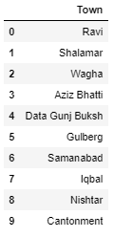
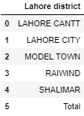
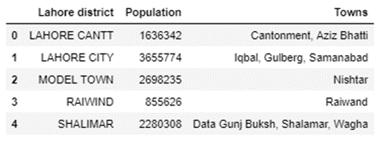
Results and Discussion
Lahore is world 24th largest city according to the population, spanning at area of 1,772 sq. km
The city is divided into 5 districts, which is further divided into 10 towns.
Due to limitations of unavailability of data population of Lahore at town level could not be extracted. Therefore, towns were categorized under districts for purpose of population distribution.

Slide 6
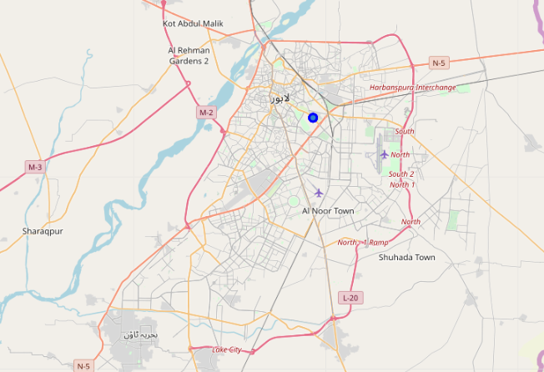
Results and Discussion
Map of Lahore

Slide 7
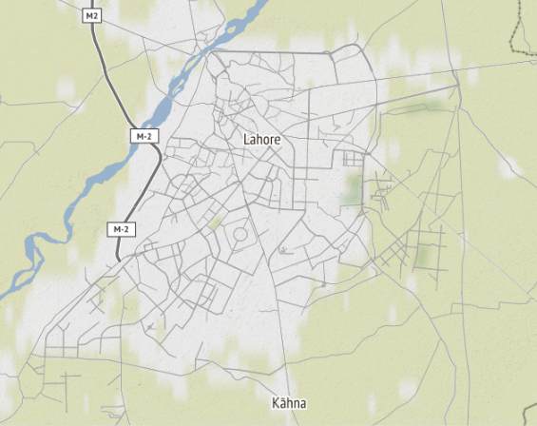
Results and Discussion
‘Green’ areas of city
Most of the greenery is found at east and south side of city

Slide 8
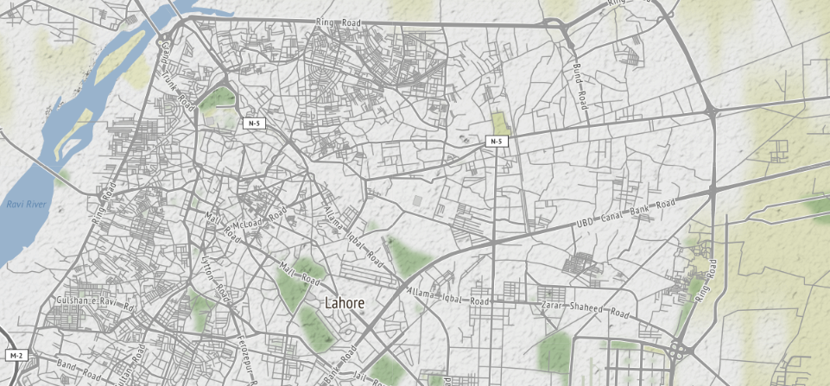
Results and Discussion
Level of forestation/greenery inside the city is little to none. There are very few parks in the city as show in pictures. Most of the greenery is found at east and south side of city

Slide 9
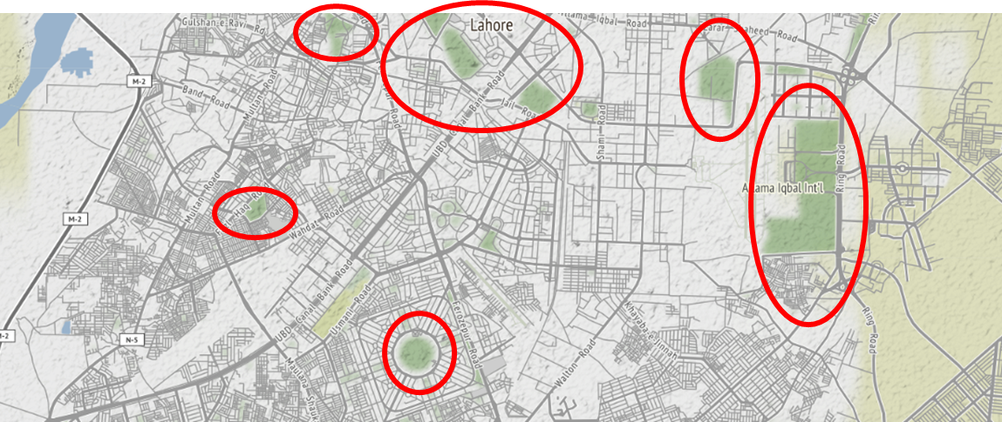
Results and Discussion
‘Green’ areas of city

Slide 10
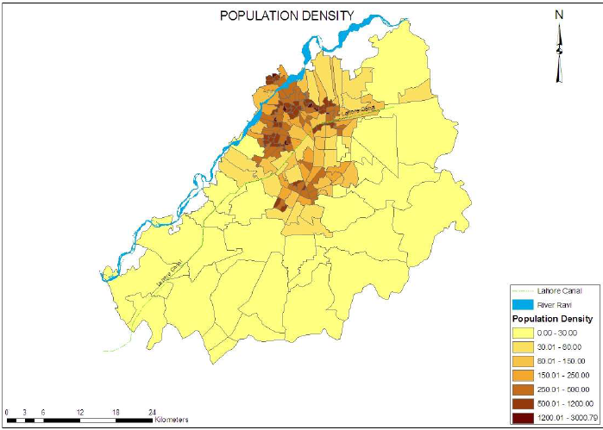
Results and Discussion
Northern part of city is highly dense.

Slide 11
Results and Discussion
Comparing the population density map and Greenery map, we can clearly see that at high population density areas there is no greenery at all.
Locations of fuel stations in the city was extracted from Foursquare
Purpose of incorporating gas stations in my study was because presence of a gas station is an indication of traffic flows hence pollution

Slide 12
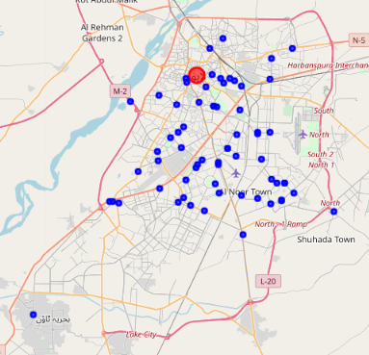
Results and Discussion
Gas stations are evenly distributed throughout the city. However, concentration of gas station in middle of city seems higher. Northern part of city, which is highly populated with very less greenery, has presence of handful of gas stations as well.

Slide 13
Conclusion
Core reason of high pollution in city is lack of forestation and greenery such as parks.
Alarming situation is present in northern part of city where population in very dense and there are hardly any parks and forestation there.
At central part of city, population is also dense, and there are high number of gas stations. Green area again is little to none.
Traffics flow is high in these areas assuming on presence of gas stations in that area, thus leading to higher pollution.
Responsible authorities should immediately address the pollution problem by building more parks and forest areas in northern and central areas of city.
Curbing pollution responsibility can be shared by individual citizen as well as they can plant trees outside their homes and neighborhood.

